Slide 1

Advanced Scientific Translation for Arabic Abstracts
Phase 1: Exploration, Preprocessing & Methodology
ASCAT Dataset | English-to-Arabic Scientific Machine Translation

Slide 2


Dataset Overview
536
Parallel Pairs
English-Arabic scientific abstracts
8
Features
Source/target abstracts, counts, metadata
5
Domains
Physics, Math, CS, Quantum, AI
0
Missing Values
Complete dataset
Source: arXiv papers (Sibaee et al., 2026). Average English length: 125 words. Average Arabic length: 112 words.

Slide 3
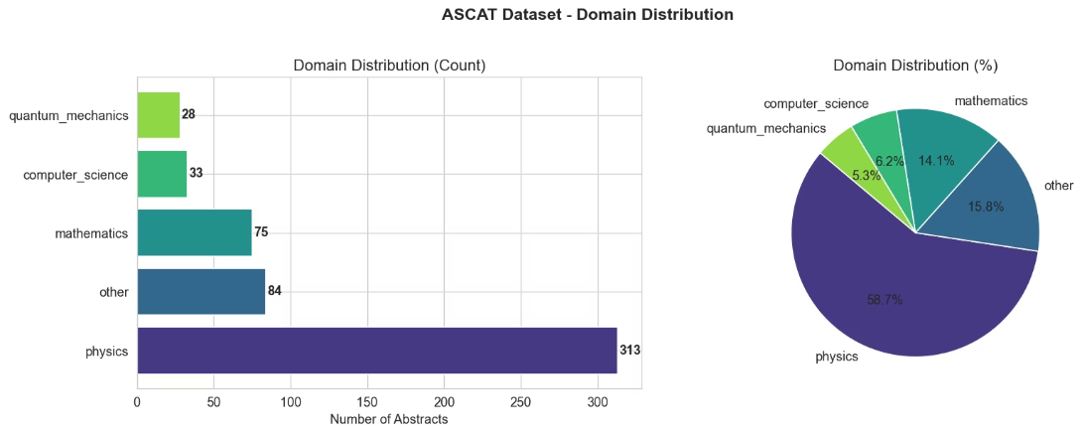
Domain Distribution
Imbalance Challenge
Physics dominates at 58.7% (313 abstracts). Other: 84, Mathematics: 75, Computer Science: 33, Quantum Mechanics: 28.
This imbalance requires preprocessing to ensure balanced training data.

Slide 4
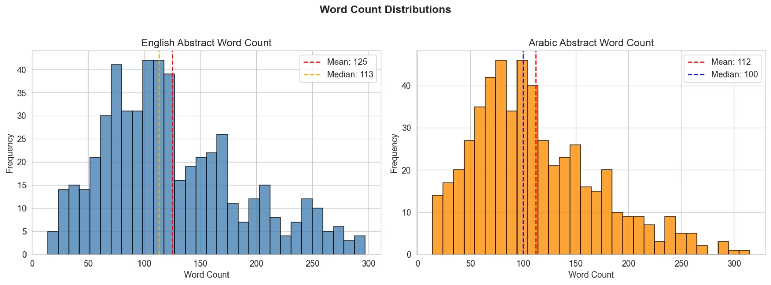
Text Length Analysis
English Abstracts
Arabic Abstracts
Mean: 125 words
Median: 113 words
Range: 3-297 words
Right-skewed distribution
Mean: 112 words
Median: 100 words
Range: 4-315 words
~90% of English length
Most abstracts fall between 50-200 words. Arabic consistently shorter due to morphological richness.

Slide 5
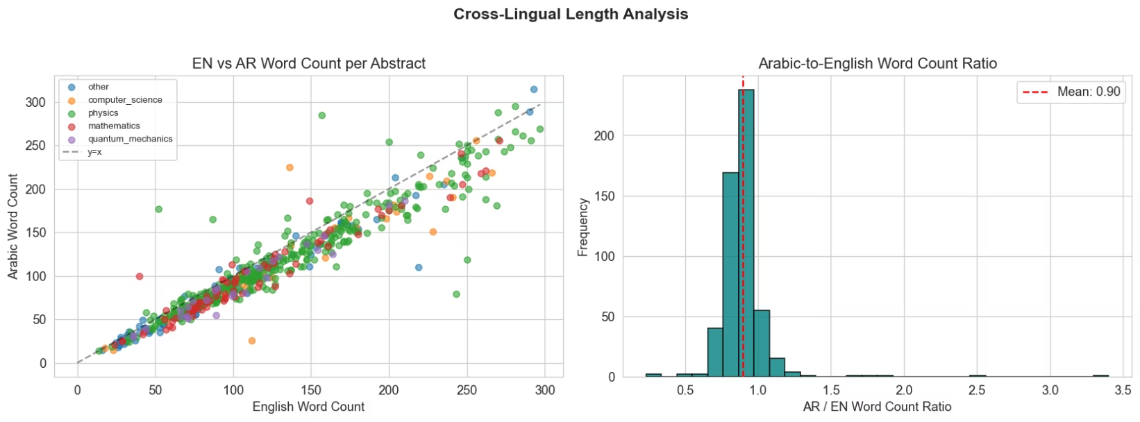
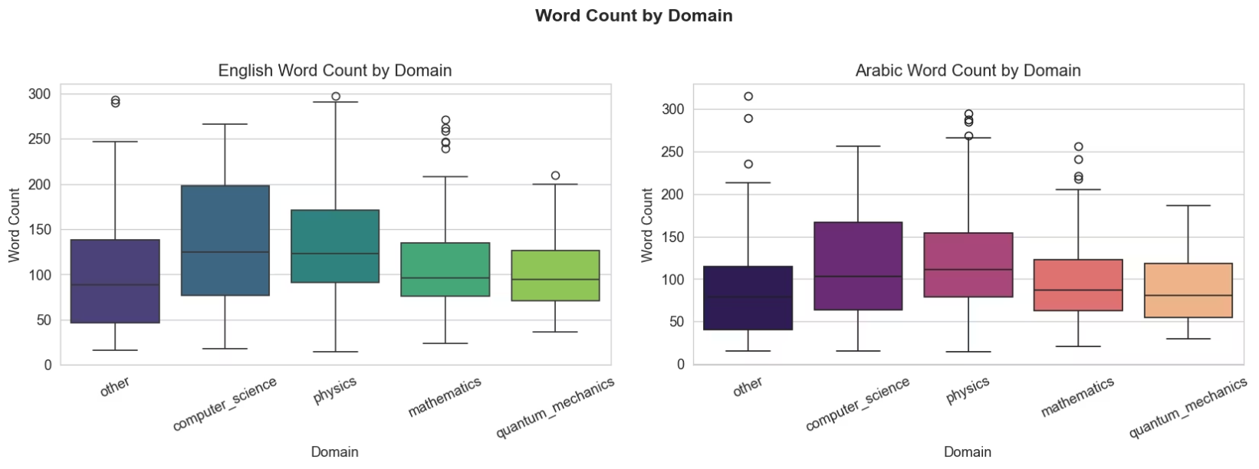
Cross-Lingual Comparison
Strong Correlation
Linear relationship between EN and AR word counts across domains
~10% Fewer Words
Arabic abstracts use ~10% fewer words than English equivalents
Morphological Richness
One Arabic word packs more meaning, reducing word count

Slide 6
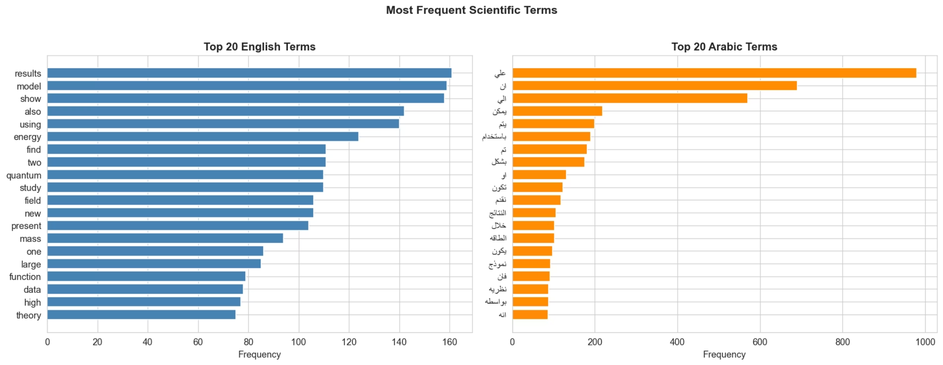
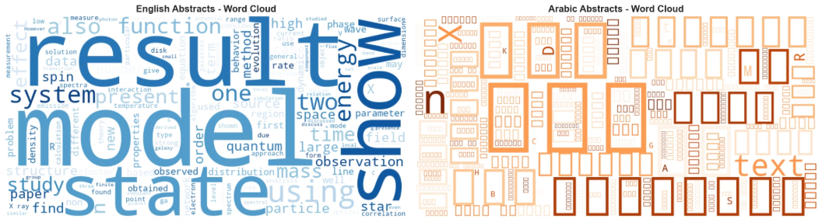
Vocabulary Analysis
English Dominant Terms
Arabic Scientific Terms
Physics-Heavy Corpus
"model", "state", "results", "energy", "quantum"
Corresponding terms appear with high frequency
Top terms reflect dataset composition

Slide 7
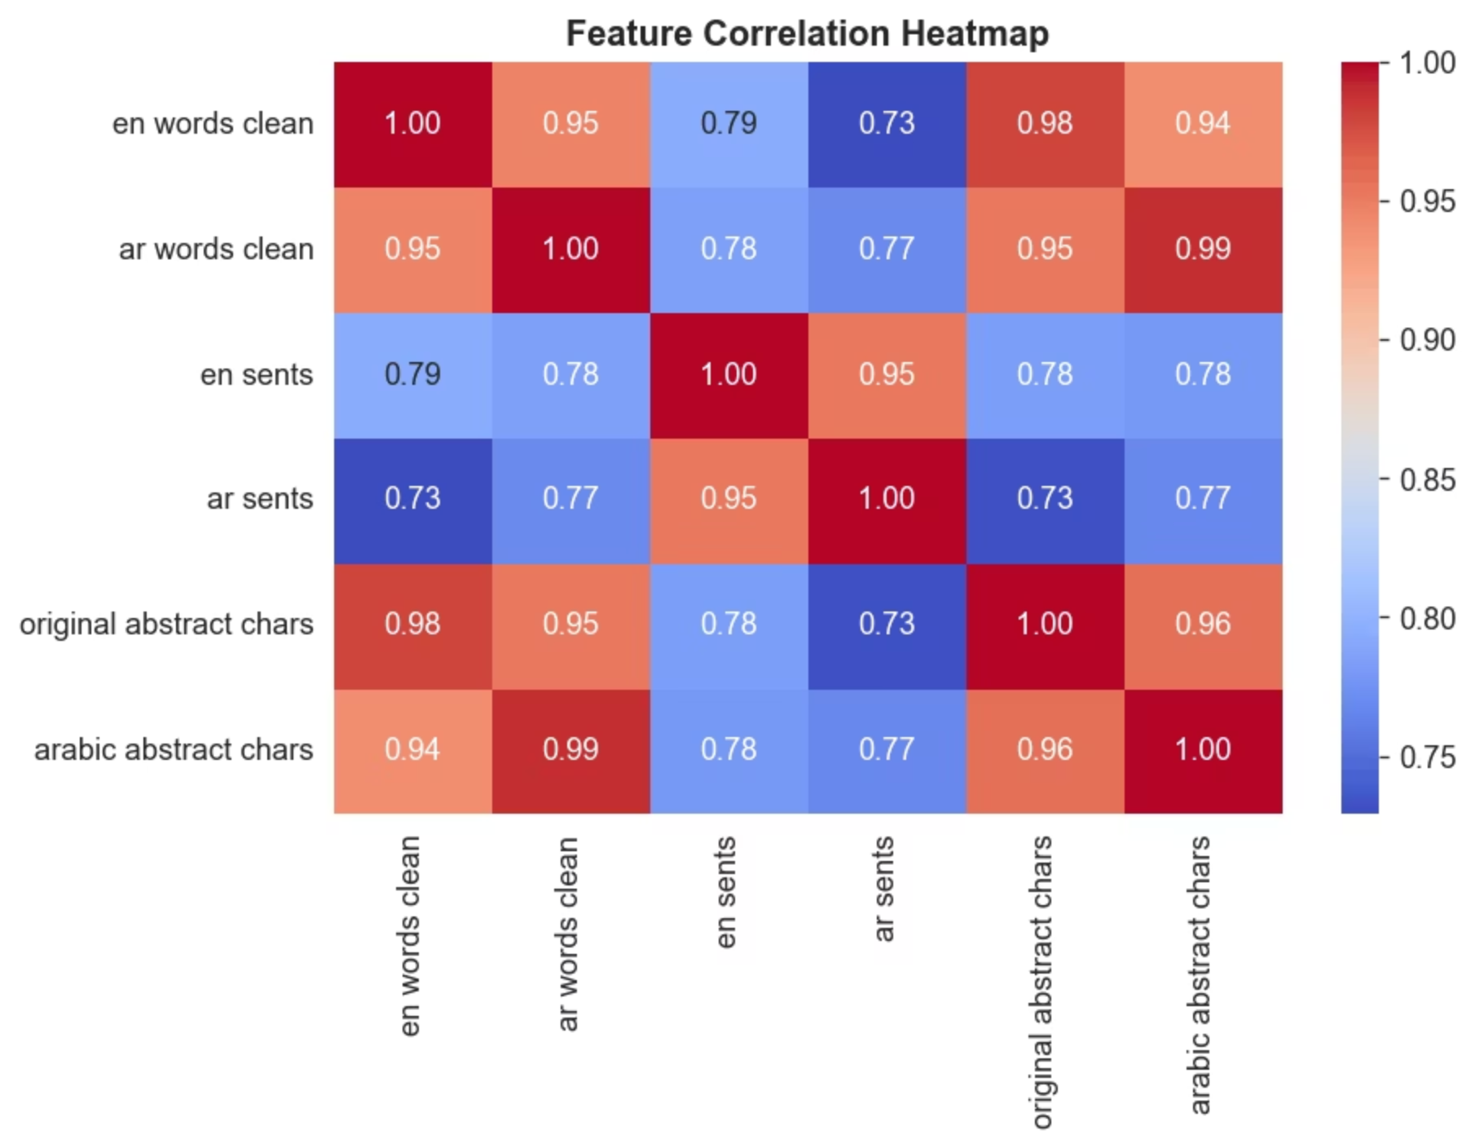
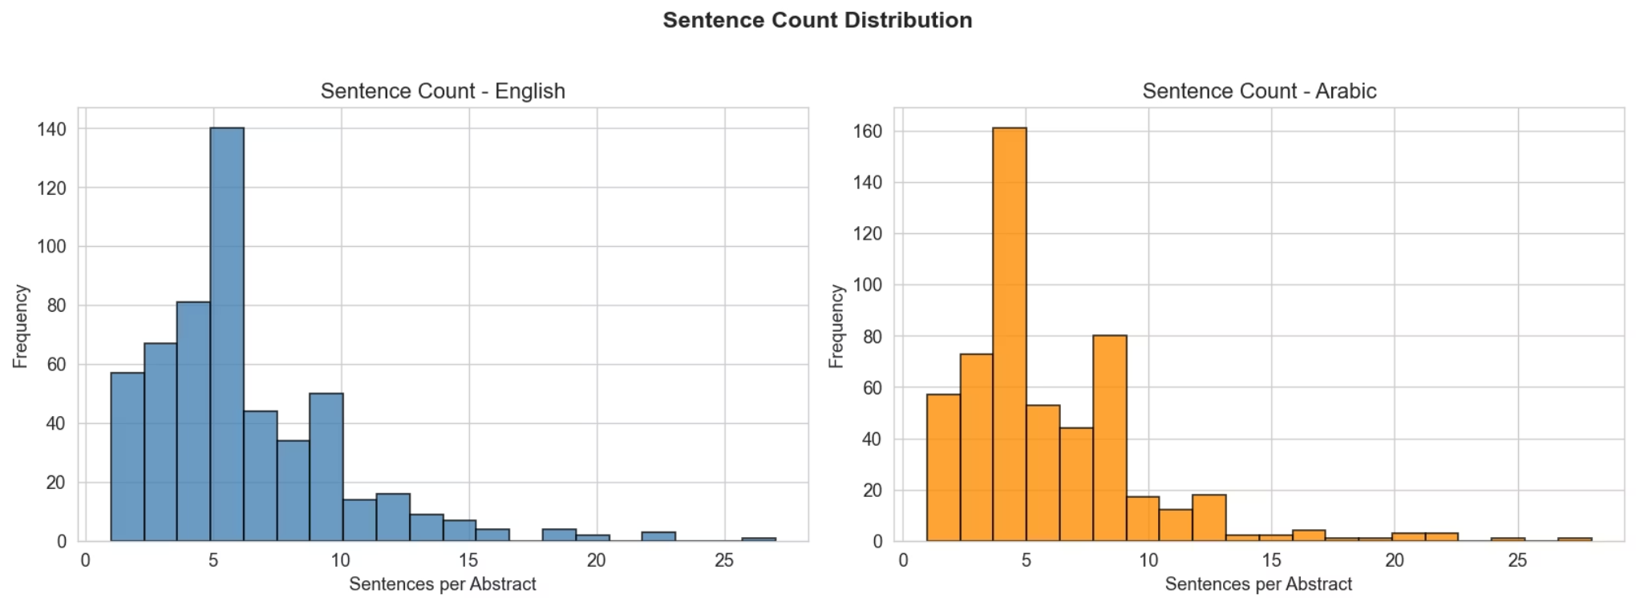
Vocabulary Richness & Correlations
Higher Arabic TTR
Arabic shows higher Type-Token Ratio across all domains, reflecting morphological richness. Quantum mechanics has highest TTR.
3-8 Sentences
Most abstracts contain 3-8 sentences.
High Correlation (0.95)
EN-AR word counts confirm translation quality preserves abstract structure.

Slide 8
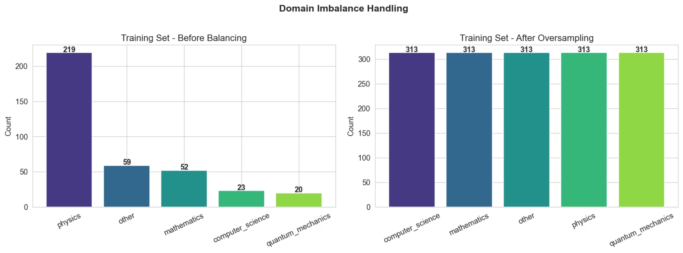
Preprocessing & Imbalance Handling
01
02
03
Text Cleaning
Arabic Normalization
Length Filtering
Remove noise and standardize format
Remove diacritics/Tashkeel, normalize Alef/Taa/Kashida
Minimum 10 words per abstract
04
05
Oversampling
Stratified Split
Balance minority domains to 313 each (1565 total training samples)
Train: 1252 (80%), Val: 156 (10%), Test: 157 (10%)
Final dataset: 1565 rows after preprocessing.

Slide 9
Literature Review
ASCAT Dataset
Transformer Architecture
NLLB Model
Sibaee et al. (2026) — source dataset paper
Vaswani et al. (2017) — foundational model
Costa-jussa et al. (2022) — Meta's 200-language MT system
mBART
Turjuman
Tang et al. (2020) — multilingual denoising pre-training
Nagoudi et al. (2022) — Arabic MT toolkit
Arabic MT Challenges
Morphological richness
Missing diacritics
Mixed-direction text
Scientific terminology gaps
Long-context coherence
Evaluation Metrics
BLEU (primary), BERTScore (semantic quality)

Slide 10






Proposed Pipeline & Methodology
Data
ASCAT 1565 pairs
Preprocessing
Clean + normalize + balance
Baseline Model
MarianMT opus-mt-en-ar (zero-shot)
Advanced Model
Fine-tune NLLB-200-distilled-600M on balanced data
Evaluation
BLEU + BERTScore + per-domain analysis
Error Analysis
Terminology accuracy, structural fidelity, domain-specific failures
Goal: Compare zero-shot vs. fine-tuned performance and identify where scientific MT fails for Arabic.

